Slide 1

Structural Health Monitoring for Civil Infrastructure Using AI and Digital Twins
Supervisor: Liu Cheng
Student: Zhang Peining (57124831)

Slide 2
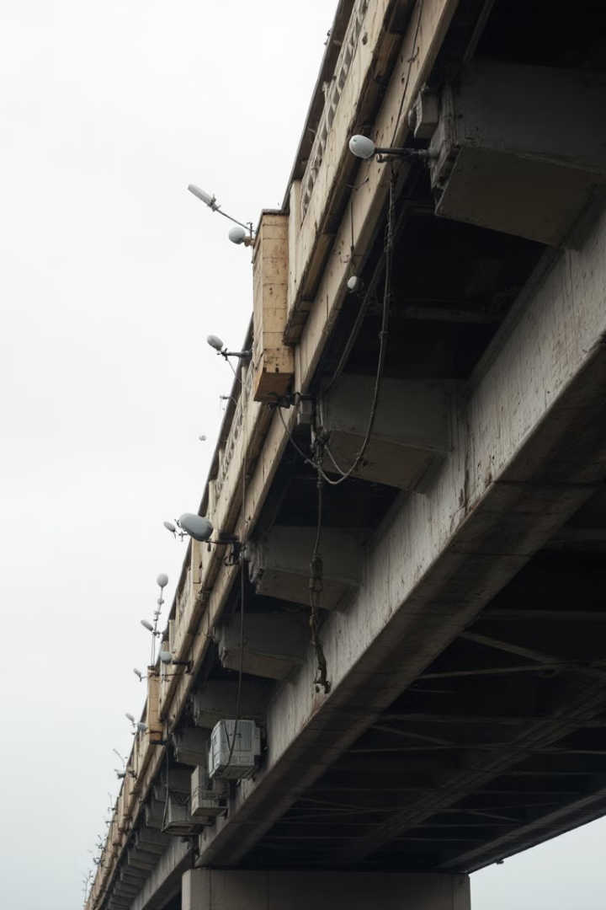
Background of SHM
1
Importance of SHM
SHM is crucial for early detection of structural defects, real-time monitoring, and safety assessment of aging infrastructure.
2
Advanced SHM Benefits
Continuous real-time monitoring enables early diagnosis, preventive maintenance, and extended infrastructure lifespan.
3
Traditional Challenges
1. Traditional techniques face challenges with large datasets, requiring extensive manual intervention that leads to delays, errors, and inefficiencies.
2. Complexity and variability of structural behaviors.
1

Slide 3




Digital Twin Technology in SHM
Virtual Replica Creation
DTs are virtual replicas of physical assets, evolving alongside real-world counterparts by integrating real-time sensor data and simulations.
Design Phase Application
Enables virtual simulations to predict structural performance under various conditions, facilitating optimal designs prior to construction.
Operational Phase Benefits
Continuously assimilates real-time data from embedded sensors, enabling real-time monitoring, fault diagnosis, and predictive maintenance.
2

Slide 4
Global Methods in SHM
Data-Driven Methods
Physics Model-Based Methods
Hybrid Techniques
Utilize statistical and machine learning techniques like PCA, SVMs, and neural networks to process vibration data for damage detection.
Employ mathematical models such as FEM to simulate structural behavior and predict damage location and severity.
Combine data-driven models with physics-based approaches to enhance robustness and accuracy of damage detection.
3
Notes:
Global SHM methods aim to detect changes in a structure's overall behavior by analyzing its dynamic characteristics, such as natural frequencies, damping ratios, and mode shapes.
Despite the advancements in deep learning-based SHM, current methodologies still struggle to achieve full automation. Replicating human perception through vibration- or vision-based deep learning algorithms remains a significant challenge

Slide 5

Local Methods in SHM
Non-Destructive Testing
Digital Twin Enhancement
Techniques like ultrasonic testing and thermography for detailed assessments of specific components or areas.
DTs provide precise simulations of localized damage, integrating real-time data with multi-physics FEM models.
Deep Learning Integration
CNN and Transformer models improve defect identification and localization in image-based NDT data.
4
Notes:
Local SHM methods focus on specific components or areas of a structure to identify and evaluate damage.

Slide 6
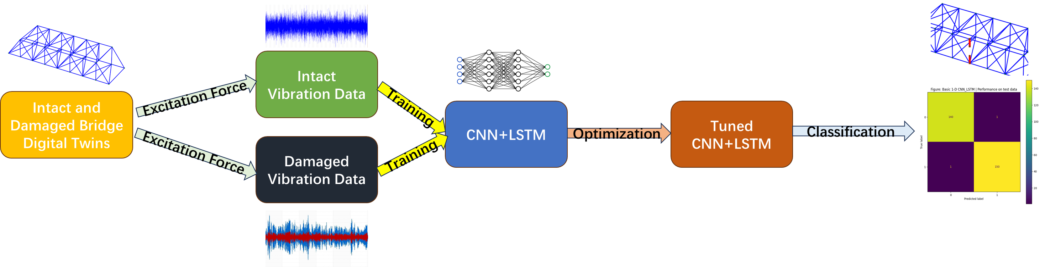
Problem Statement and Methodology
1
Challenge
2
Proposed Solution
3
Approach
Addressing limitations in DT accuracy due to environmental noise, measurement errors, and computational constraints.
Develop a high-performance hybrid machine-learning model leveraging DT-generated data for bridge health monitoring.
Integrate 1-D CNN and LSTM architectures, employing Bayesian optimization for model structure refinement.
5
Notes:
Effective models are needed to process complex datasets and address these limitations.

Slide 7
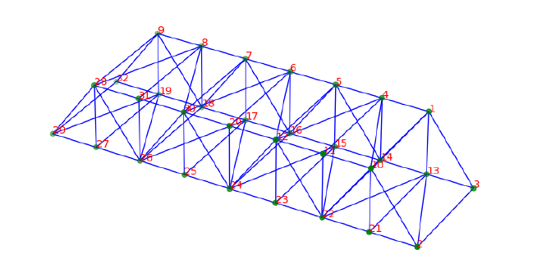
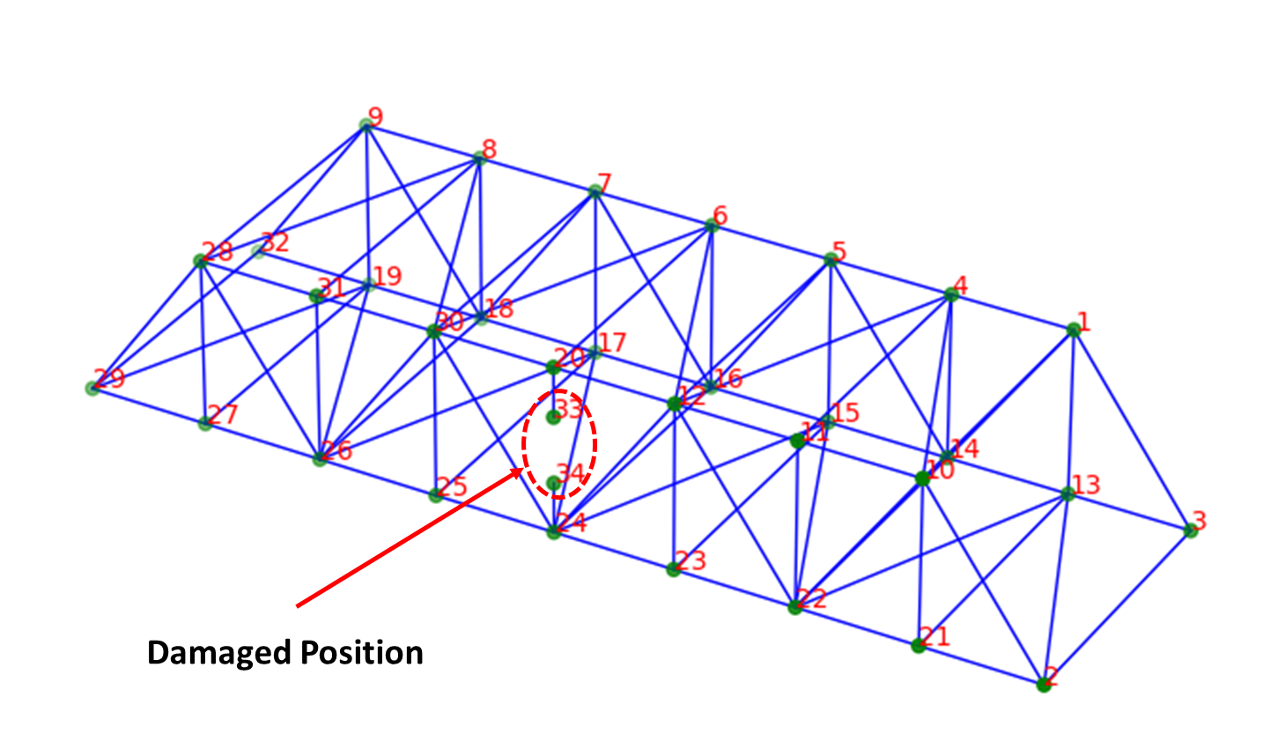
Data Collection
External Force
External Force
6

Slide 8
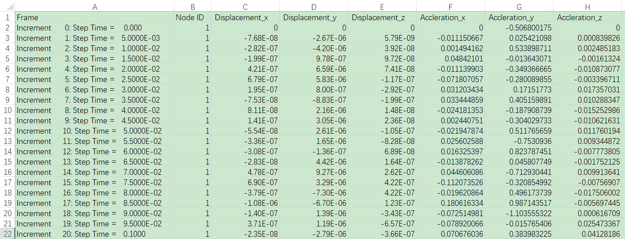
Data Collection
7

Slide 9
Model Implemented
Feature | 1D CNN | LSTM | CNN-LSTM
Feature Extraction | Efficient at detecting local patterns, such as peaks, trends, and periodicity in data. | Captures long-term dependencies and complex temporal patterns. | Combines local pattern detection (CNN) with temporal dependency modeling (LSTM).
Temporal Dependency | Focuses on short-term dependencies using fixed-length windows. | Excels in modeling both short-term and long-term dependencies. | Handles both short- and long-term dependencies effectively.
Speed | Faster training and inference due to parallelized operations. | Slower training and inference due to sequential processing. | Moderate speed, as CNN handles feature extraction before passing data to LSTM for sequential modeling.
Parameter Efficiency | Fewer parameters compared to LSTM, reducing overfitting risks with smaller datasets. | Requires more parameters, which can be computationally intensive. | Balances parameter efficiency by limiting the LSTM's input to features extracted by the CNN.
8

Slide 10
Normalized using standardization, ensuring that each component had a mean of 0 and a standard deviation of 1.
The dataset was split into training, validation, and test sets with proportions of 60%, 20%, and 20%, respectively.
The model was trained using the Adam optimizer with an initial learning rate of 0.001 and a batch size of 32.
Cross-Entropy Loss was employed as the loss function to calculate the difference between the predicted logits and the true labels.
A learning rate scheduler, ReduceLROnPlateau, monitored the validation loss during training and reduced the learning rate by a factor of 0.1 if no improvement was observed for 7 consecutive epochs.

Slide 11
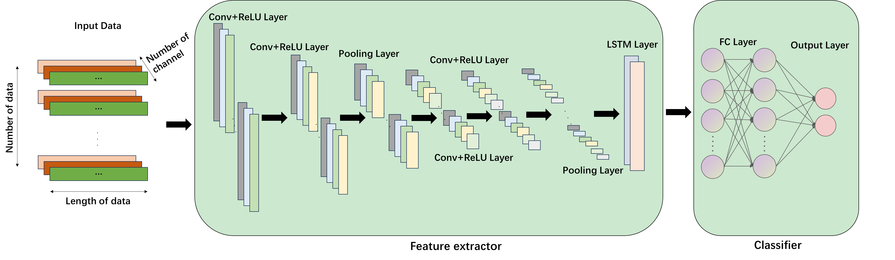
Model Implemented
9

Slide 12
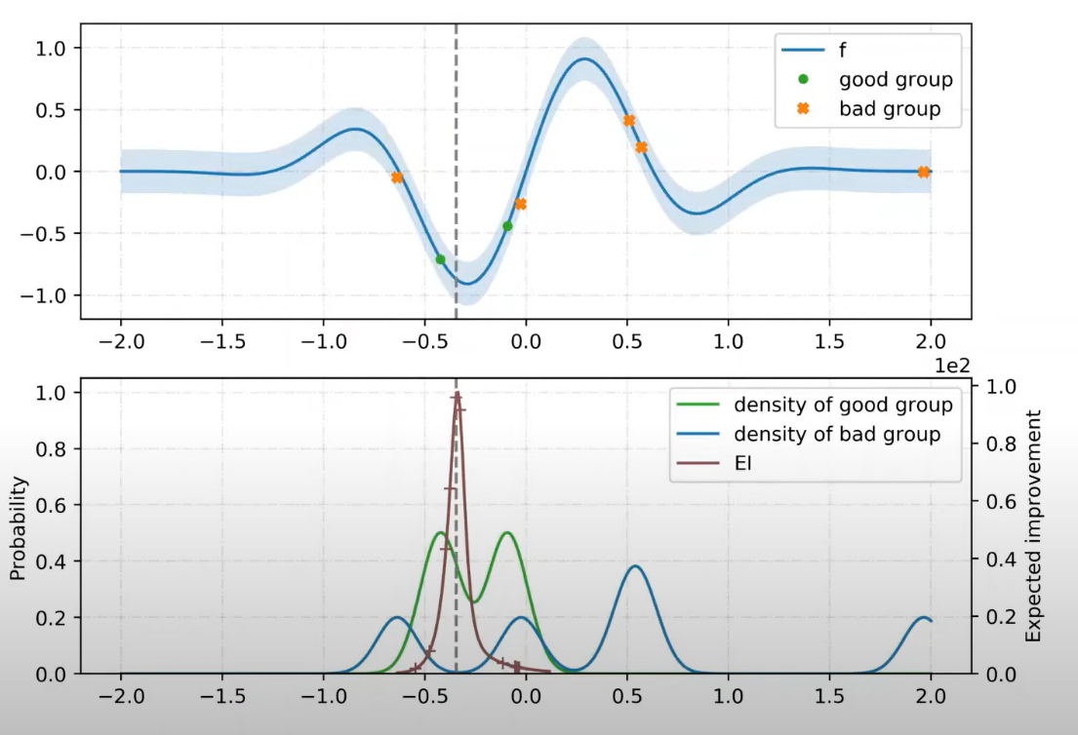
Model Optimization—Tree structured Parzen Estimators
Initially random select hyperparameter configurations
Evaluate the Objective Loss Function
Sort the Candidate points
Split into 'Good Points' and 'Bad Points'
Generate New Candidate Points by computing the ratio of 'Good Points' and 'Bad Points'
Kernel Density Estimation
10

Slide 13
Use for TPE
'num_layers': trial.suggest_categorical('num_layers', [1,2,3,4]),
'hidden_size': trial.suggest_categorical('num_hidden_units', [32,64,128,256])

Slide 14
Results for only Y-axis vibration signal
Accuracy | Precision | Recall | F1-Score
99.32% | 99.32% | 99.32% | 99.32%
Evaluation metrics of the testing data
11

Slide 15
Results for all three axis vibration signals
Accuracy | Precision | Recall | F1-Score
76.03% | 76.75% | 76.03% | 75.95%
Evaluation metrics of the testing data
12

Slide 16

Next Steps and Future Work
1
Data Sampling Optimization
Employ Bayesian optimization to determine optimal locations and number of sampling points, reducing data collection costs while maintaining accuracy.
2
Model Structure Refinement
Address overfitting issues through regularization techniques and cross-validation, followed by hyperparameter optimization for improved performance.
3
Comparative Analysis
Explore alternative pretrained models and machine learning approaches to identify the most effective solution for bridge health monitoring.
13

Slide 17
对y方向上的数据点分析，取最优点，可以通过加超参数然后利用优化来找到最优的点
先让每个点都受到外力，再选取某几个点的震动数据来进行训练（现实生活中来监测特定点的震动数据从而可以减少sensor的数量）
考虑到实际生活中桥梁受到的力可能来自各个地方，所以我就选取所有受到外力的点来模拟生活中来自四面八方的力，然后选取10个点来作为安装sensor的点
选取某几个点受到外力，再从这几个点的csv中选取所有点的震动数据进行训练
对比试验，用不同模型/拼接其他模型来比较模型性能
将xyz三个方向的点按照不同方式堆叠，来检验xyz是否效果好
可视化y的震动分布和xz的震动分布

